Slide 1


IoT-Based Smart Soil Moisture Monitoring and Rain Prediction System
Using Soil Moisture Sensor & Arduino with Plant-Based Moisture Optimisation
Team Members:
[1.Ramanaujam K - 210425106173]
[2.Tharun D - 210425106248]
[3.Logesh G - 210425106106]
[4.Tareesh R - 210425106245]
[5.Manish B - 210425106032]
[6.Nithyanandan P - 21045106144]
[7.Muthukumaran T - 21045106131]
[Chennai Institute of Technology] — Department of Electronics & Communications Engineering
DEPARTMENT OF ECE
CHENNAI INSTITUTE OF TECHNOLOGY(An Autonomous Institution)

Slide 2
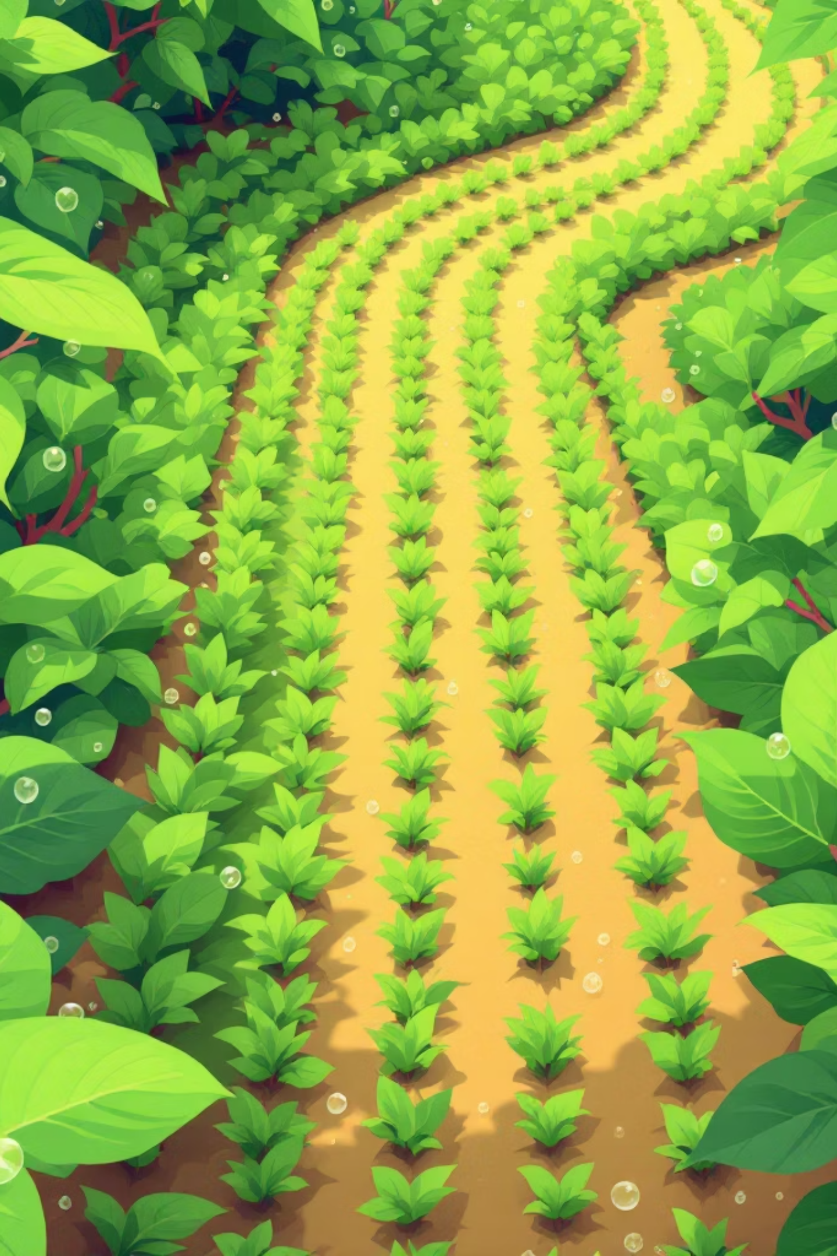
Why Smart Irrigation Matters
Water Is a Finite Resource
Agriculture accounts for over 70% of global freshwater use, yet traditional irrigation wastes up to 50% of water through over-watering and poor timing.
Water Conservation
Reduce unnecessary water usage
Automation offers a precise, data-driven alternative — delivering the right amount of water, to the right plant, at the right time.
Smart Automation
Sensor-driven, real-time decisions
Plant Health
Optimised moisture per plant type
DEPARTMENT OF ECE
CHENNAI INSTITUTE OF TECHNOLOGY(An Autonomous Institution)

Slide 3
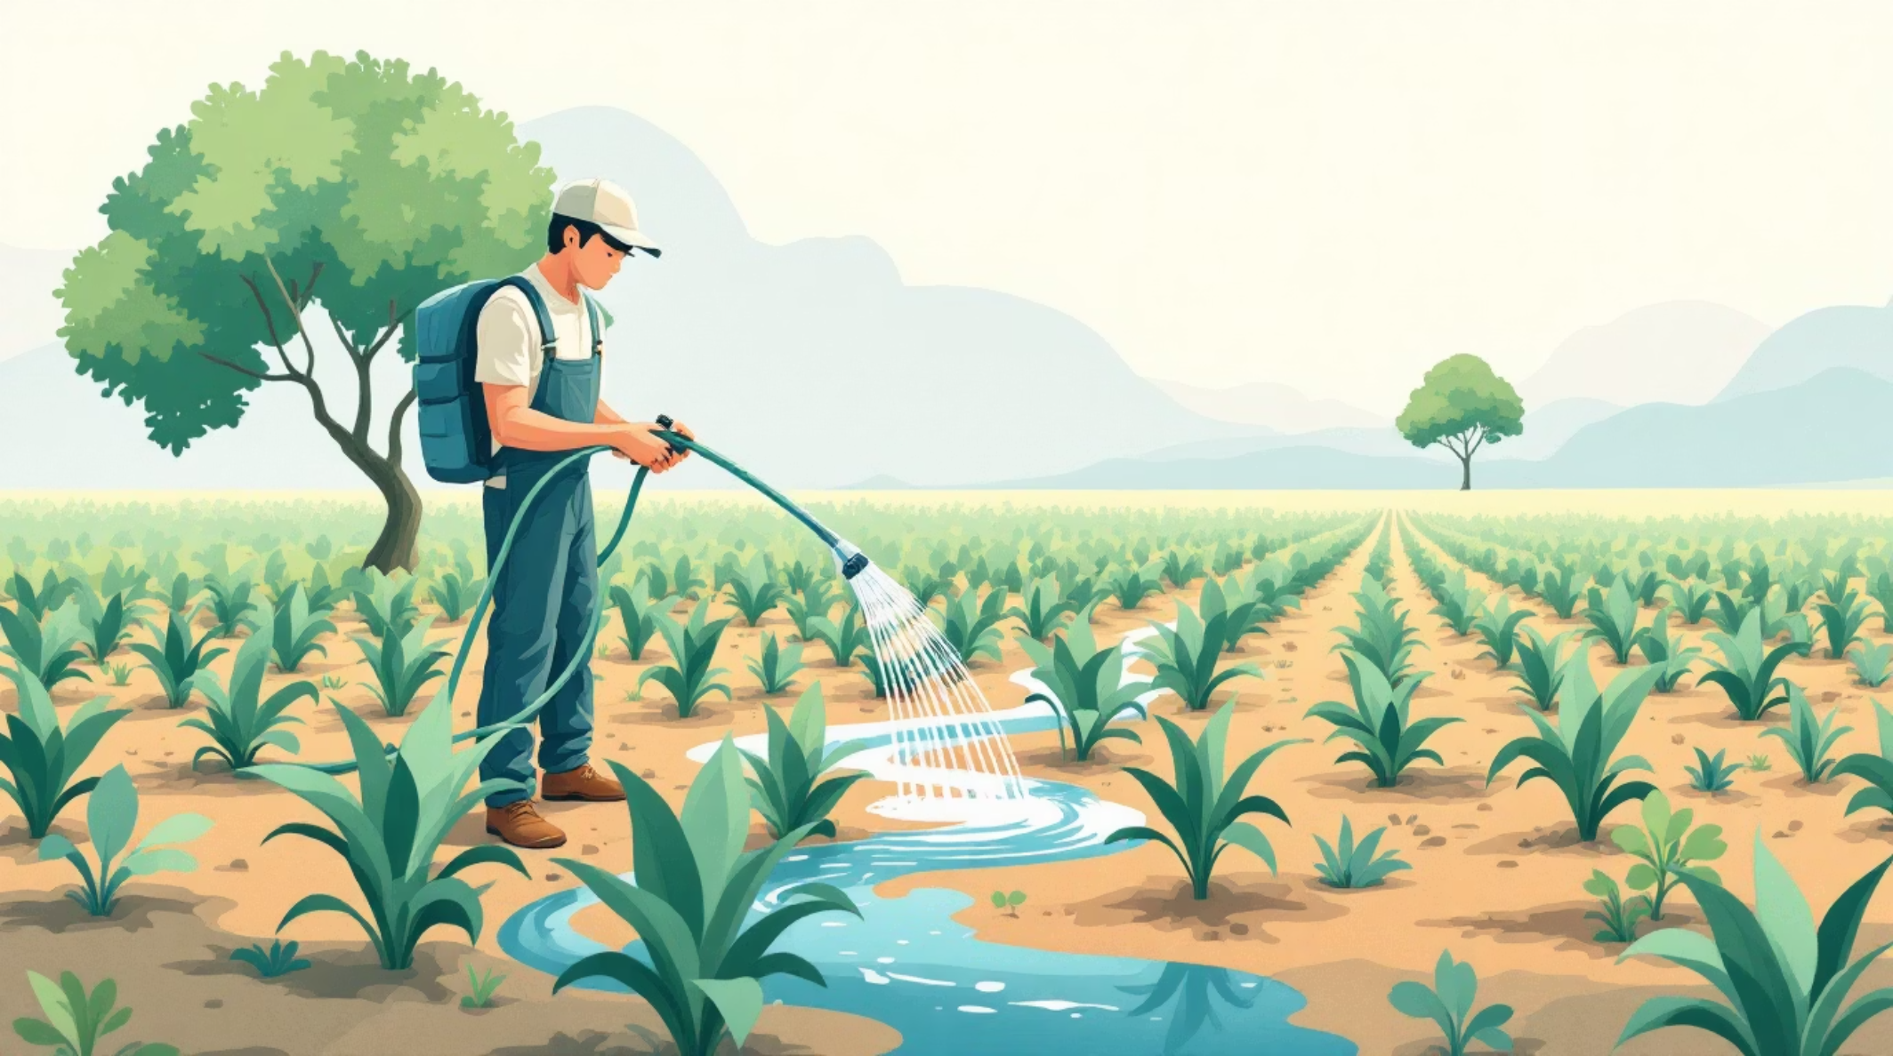
Problem Statement
What Goes Wrong with Traditional Irrigation?
Excessive Water Wastage
Fixed schedules ignore actual soil conditions, leading to over-irrigation and significant water loss.
No Plant-Specific Guidance
All plants receive the same amount of water — ignoring that a cactus and a rose have very different moisture needs.
Manual Monitoring
Farmers rely on guesswork or visual inspection, which is unreliable and labour-intensive.
DEPARTMENT OF ECE
CHENNAI INSTITUTE OF TECHNOLOGY(An Autonomous Institution)

Slide 4
Project Objectives
Four clear goals that drive this project from concept to implementation.
Automate Irrigation Indication
Reduce Water Usage
Plant-Specific Moisture Guidance
Improve Decision-Making
Prevent over-watering by irrigating only when soil moisture falls below optimal thresholds.
Use real-time sensor data to trigger visual LED alerts without human intervention.
Provide a reference website listing ideal moisture levels for different plant species.
Bridge hardware sensing with software intelligence for smarter irrigation choices.
DEPARTMENT OF ECE
CHENNAI INSTITUTE OF TECHNOLOGY(An Autonomous Institution)

Slide 5

System Overview
The system integrates hardware sensing with a software layer for complete, intelligent irrigation monitoring.
Soil Sensor
Arduino Uno
Dual LED
Website
The sensor feeds analogue readings to the Arduino, which evaluates them against plant-specific thresholds. The result is displayed instantly via LED indication, while the companion website empowers users to match irrigation decisions to their specific plant type.
DEPARTMENT OF ECE
CHENNAI INSTITUTE OF TECHNOLOGY(An Autonomous Institution)

Slide 6
Components Used
Arduino Uno
Soil Moisture Sensor
Red LED
Green LED
Microcontroller — reads sensor data and executes logic
Analogue output (0–1023) measuring volumetric water content
Indicates dry soil — watering required
Indicates wet soil — no irrigation needed
Resistors & Wires
220Ω resistors for LED protection; jumper wires for circuit connections
DEPARTMENT OF ECE
CHENNAI INSTITUTE OF TECHNOLOGY(An Autonomous Institution)

Slide 7


Rain Prediction Integration
Enhance irrigation decisions by factoring in upcoming weather conditions.
How it Works
Integrates real-time data from a trusted weather forecasting website.
Provides information on expected rainfall probability and intensity for the user's location.
Suggests whether to postpone watering if rain is imminent, preventing over-irrigation.
Empowers users to make informed decisions, optimising water usage and ensuring plant health.
Weather API Data
Real-time forecast inputs
Irrigation Decision Flow
User Irrigation Decision
Our System's Website
Adjusts watering based on forecasts
Processes and displays forecasts
This integration provides a holistic view, combining real-time soil moisture data with predictive weather patterns for truly smarter watering strategies.
DEPARTMENT OF ECE
CHENNAI INSTITUTE OF TECHNOLOGY(An Autonomous Institution)

Slide 8


Working Principle & Circuit Connections
Circuit Pin Mapping
Compare Threshold
Arduino checks value against setpoint
Component
Arduino Pin
Sensor Analogue Out (AO)
A0
Sensor VCC
5V
Sensor GND
GND
Red LED (Dry)
Digital Pin 8
Green LED (Wet)
Digital Pin 9
Read Sensor
Drive LEDs
A 220Ω resistor is placed in series with each LED to prevent overcurrent and protect the Arduino's output pins.
Analog value 0–1023 from A0
Red for dry, Green for wet (pins 8/9)
DEPARTMENT OF ECE
CHENNAI INSTITUTE OF TECHNOLOGY(An Autonomous Institution)

Slide 9

Software Logic
Core Arduino Code Logic
Decision Flow
int sensorValue = analogRead(A0);
int threshold = 500;
if (sensorValue > threshold) {
// Soil is DRY
digitalWrite(8, HIGH); // Red ON
digitalWrite(9, LOW); // Green OFF
} else {
// Soil is WET
digitalWrite(8, LOW); // Red OFF
digitalWrite(9, HIGH); // Green ON
}
Wet: Green ON
Green HIGH, Red LOW
Dry: Red ON
Red HIGH, Green LOW
Compare Threshold
if value > 500
Read Sensor
analogRead(A0)
The threshold value can be adjusted based on soil type and plant-specific requirements sourced from the companion website.
DEPARTMENT OF ECE
CHENNAI INSTITUTE OF TECHNOLOGY(An Autonomous Institution)

Slide 10

Website Integration — The Key Innovation
MAIN INNOVATION
What the Website Provides
🌹 Rose
Ideal moisture level (sensor range) for each plant species
Recommended watering frequency and quantity
Threshold value to programme into the Arduino
Visual status indicator: Dry / Adequate / Wet
Ideal: 400–550 · Water frequently
🌵 Cactus
Ideal: 100–250 · Water sparingly
🌿 Basil
This bridges the hardware system with actionable, plant-specific intelligence — turning a simple LED indicator into a smart, context-aware irrigation advisor.
Ideal: 500–650 · Keep consistently moist
🌾 Wheat
Ideal: 350–500 · Moderate irrigation
DEPARTMENT OF ECE
CHENNAI INSTITUTE OF TECHNOLOGY(An Autonomous Institution)

Slide 11
Advantages, Limitations & Future Scope
Advantages
Limitations
Saves Water
Sensor Accuracy
Manual Threshold
Irrigates only when soil is genuinely dry
Readings may drift with soil type or sensor age
User must programme threshold from website data
Low Cost
Built with affordable, widely available components
Indication Only
Does not directly control a water pump — yet
Easy to Use
Future Scope
Visual LED output requires no technical expertise
Plant-Smart
Pump Control
Website guidance personalises irrigation per species
Auto-trigger irrigation pump
IoT Integration
Remote monitoring via cloud
Mobile App
Real-time alerts on smartphone
AI Plant Care
Predictive, self-learning irrigation
DEPARTMENT OF ECE
CHENNAI INSTITUTE OF TECHNOLOGY(An Autonomous Institution)

Slide 12
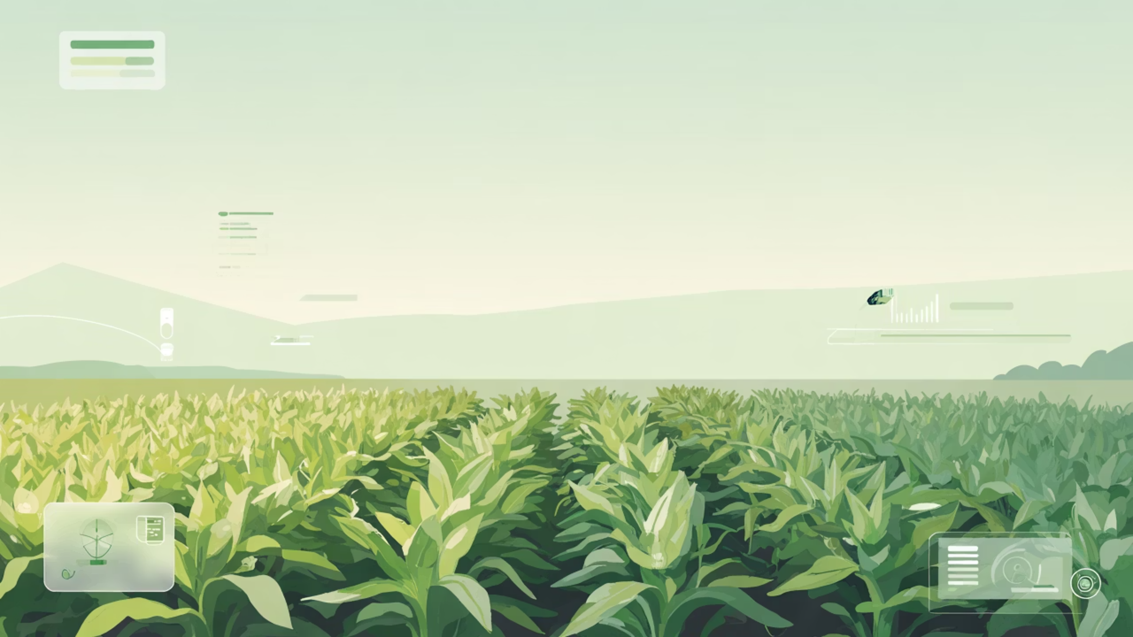
Thank You!
We envision a future where intelligent irrigation systems empower sustainable agriculture and optimise resource management.
DEPARTMENT OF ECE
CHENNAI INSTITUTE OF TECHNOLOGY(An Autonomous Institution)

